Slide 1

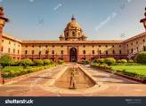
WELCOME TO THE CHAPTER
WHO GOVERNS?

Slide 2

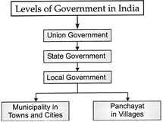
STRUCTURE OF THE GOVERNMENT

Slide 3
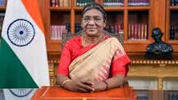
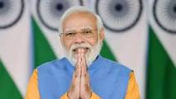
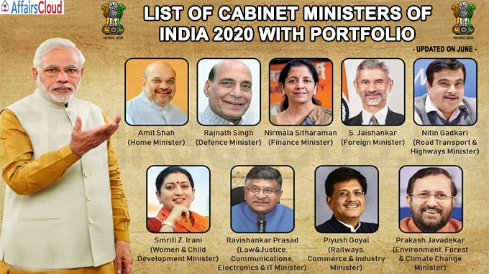
NATIONAL REPRESENTATIVES
President
prime Minister
Union Ministers

Slide 4
Union Ministers
Shri Raj Nath Singh | Minister of Defence
Shri Amit Shah | Minister of Home Affairs;
Shri Nitin Jairam Gadkari | Minister of Road Transport and Highways
Smt. Nirmala Sitharaman | Minister of Finance;
Shri Narendra Singh Tomar | Minister of Agriculture and Farmers Welfare
Dr. Subrahmanyam Jaishankar | Minister of External Affair
Shri Arjun Munda | Minister of Tribal Affairs
Smt. Smriti Zubin Irani | Minister of Women and Child Development
Shri Dharmendra Pradhan | Minister of Education; and Minister of Skill Development and Entrepreneursh

Slide 5
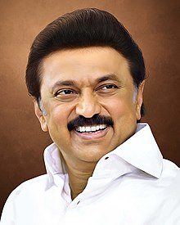
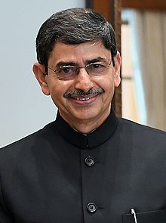
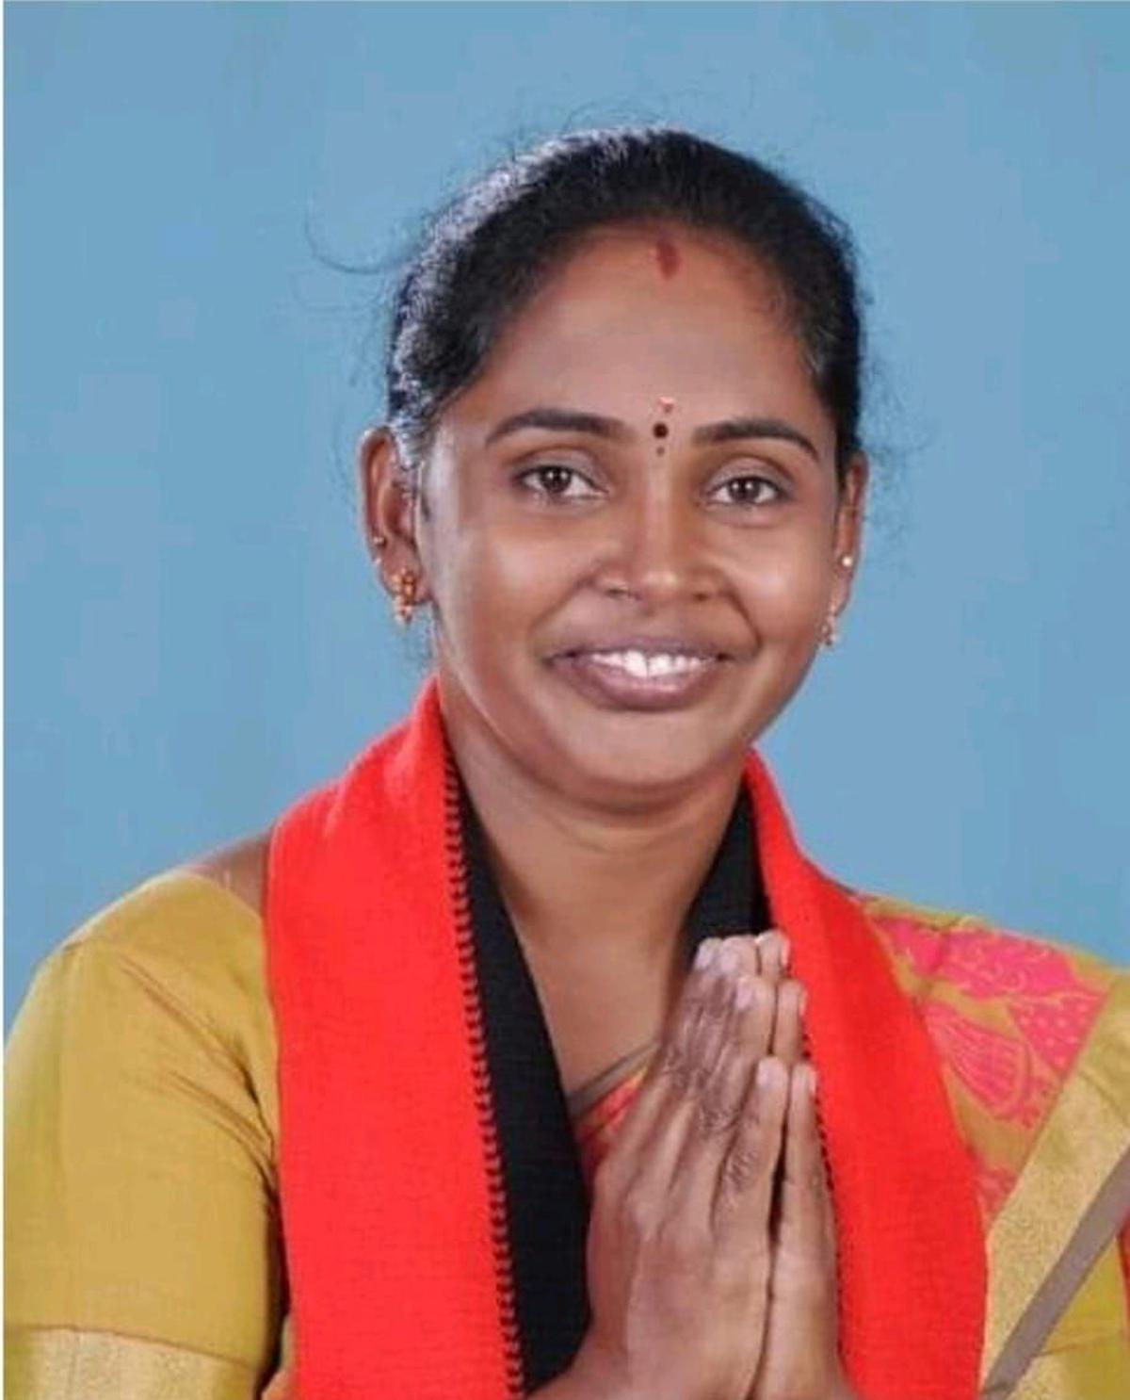
State and Local representatives
State
CM of Tamil Ndu MK Stalin
Governour of Tamil Nadu-R N Ravi
Local
First female Mayor of Coimbatore A Kalpana

Slide 6
write any five Ministers name with department.

Slide 7

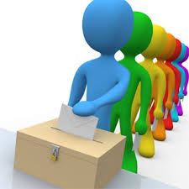
Concept of selection and election;
Select is mostly used in reference to a choice made by an individual, whereas elect generally refers to the selection made by a group of people, keeping in view, the liking of maximum people.
Election is the process by which people elect a person who will hold a certain office. Therefore, elections play a vital role in any democratic society or country.
example:
1. She selected her dresses for the wedding.
2. He can select a subject of his choice.
3. He was elected as the President of the union.
4. We should always elect strong leaders.

Slide 8
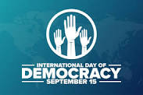
Democracy
Democracy is a form of government where elected representatives hold power. Citizens elect their representatives through voting and these elected representatives hold the power.

Slide 9
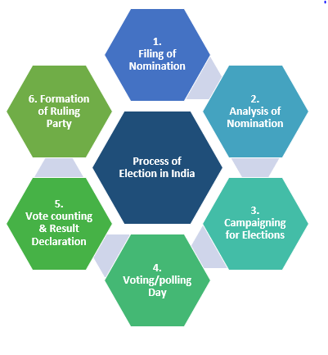
The election process
the election process

Slide 10
Points to remember in the election process.
Announcement of election and dates.
Filing of nominations.
Campaigning.
On voting day polling officer check the valid voter id.
Cast the vote through EVM(electronic voting mechine)
Polling officer place an ink mark on index finger.
counting votes.
Result-The name of candidate with maximum number votes declared the winner.

Slide 11
1.Write example of difference between election and selection.
2. Make your imaginative voter ID card would look like when you are 18.

Slide 12
Importance of Voting.
India is one of the largest democracies in the world. The notion ‘Government of the people, by the people and for the people’ holds true only when the entire nation participates in the election process. In a true form of democracy, all the citizens come together to decide the future of the country and thereby their own.
A voter’s responsibility to vote responsibly is one of the strongest pillars of a democracy. Since voting is not made mandatory by the government, it is the moral duty of the citizens of the country to come forward and carry out this duty voluntarily.

Slide 13
I.Answer the questions.
1. Who is the Education minister of india?
2. The coutry where people choose their representative is called-----
3.Who takes responsibility of election....
4.President and prime minister are the representatives of which government?
5. Mayor and muncipal commssioner are reprentative of which goverment?
II.State the statement true or false.
1.Citizen above 15 age can cast their vote.
2.Chief Minister is the representative of state government.
3.Voting is not important in democratic country.
4.Local govrnment look after roads,public transport and water supply.
5.Election and Selection both are same concept.

Slide 14

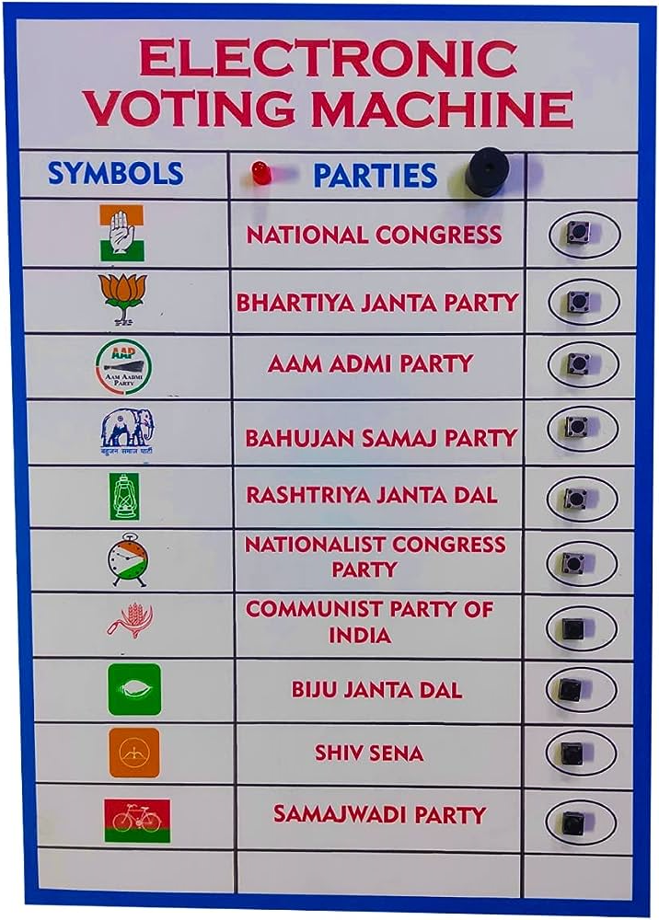
ELECTRONIC VOTING MACHINE

Slide 15
ANSWERS
I.
1.Shri Dharmendra Pradhan
2. Democratic country
3.The election commission.
4.Central government.
5.Local government.
II.
1.False
2. True
3. False
4.True
5.False

Slide 16
THANK YOU

